Slide 1

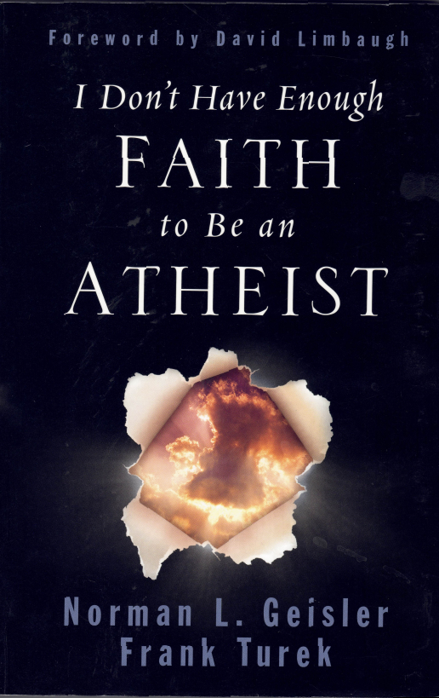
Chapter 12
Section 2
Were + They Corroborated?
Notes:
So far we verified that the gospel writers were present during the time period they claimed to write about.
But were their claims Corroborated?

Slide 2
Corroborate
”to support with evidence or authority”
Will show corroboration from: -historical secular writings -archaeology -language -unintentional gospel support

Slide 3
Skeptic Quotes
“The word god is for me nothing more than the expression and product of human weaknesses, the Bible a collection of honourable, but still primitive legends which are nevertheless pretty childish. No interpretation no matter how subtle can (for me) change this.” —Albert Einstein, father of modern physics
Notes:
Einstein may have been an expert in physics, but apparently was weak on the facts in other fields of study, as we’ll demonstrate

Slide 4
Skeptic Quotes
“Is there an intelligent man or woman now in the world who believes in the Garden of Eden story? If there is, strike here (tapping his forehead) and you will hear an echo. Something is for rent.”
—Robert Green Ingersoll, the nineteenth-century American political leader known as “The Great Agnostic”
Notes:
One who is a skeptic of one thing is a true believer in another.
It is easy to smell a rotten egg.
It’s much harder to lay a new one.

Slide 5

Skeptic Quotes
“I think that the people who think God wrote a book called the Bible are just childish.”
—Bill Maher, comedian, television host, and political commentator

Slide 6
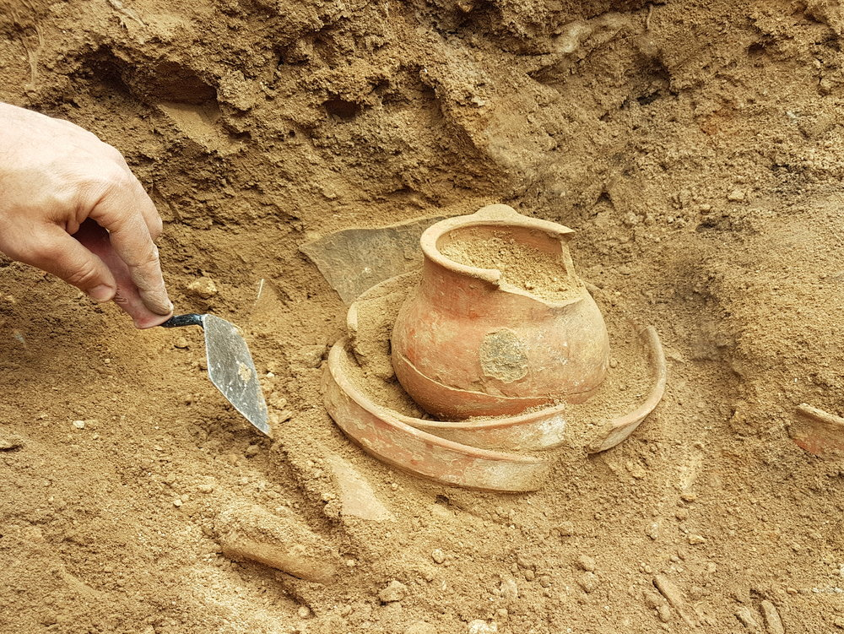
Corroboration from Archaeology
Notes:
Here are some examples (next slide)

Slide 7
Skeptics Thought These Didn’t Exist
Quirinius(a governor): (Luke 2:1-3) Roman governor of Syria during the census. Until “Antioch Inscription” found
The Pavement(a place): (John 19:13) Pilate condemned Jesus there Until discovered at “Tower of Antonia”
Pontius Pilate(a person: (from the gospels) Until “Pilate Inscription” found in 1961
Roman Crucifixion: (from the gospels) Until “Yohanan Remains” revealed crucifixion nails in skeletal remains
Notes:
-Quirinius:: Held several political offices. Also mentioned by 6+ historical figures.
-Pontius Pilate::
Inscription showed a building dedication to the Roman emperor.

Slide 8
Or These
Lysanius(a governor): (Luke 3:1) Until the “Lysanias Inscription” found
Iconium(a place) (Acts 14:6,13:51) -a city in Phyrigia Until the “Iconium Monument” found in 1910 AD
Politarch(a title) (Acts 17:6) Until 19 inscriptions discovered
Sergius Paulus(a politician) (Acts 13) -Proconsul under Claudius Until “Soli Inscription” found

Slide 9
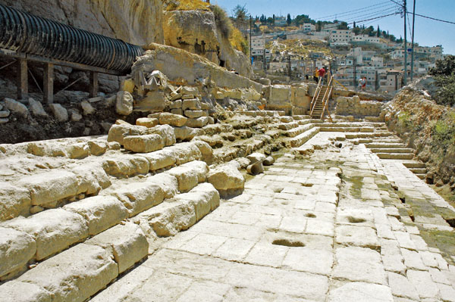
Or These
Erastus: (Romans 16:23) -a city treasurer Until pavement in Corinth confirmed existence
Pool of Siloam: (John 9:1-12, Isaiah 8:6,22:9) Until excavated in 2004
Notes:
------------------------------------------------------------------------
Extra…
Erastus – AD 1910

Slide 10
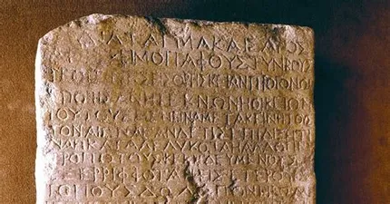
Decree against grave robbing
“Nazareth Stone” discovered in late 1900’s
“Ordinance of Caesar: It is my pleasure that graves and tombs remain perpetually undisturbed… Ordered the death penalty for anyone -demolishing -extracting -transferring -breaking seals on tombs
Matches gospel narrative about guards being bribed to lie. This is the reasonable response from an emperor who believed the lie that the disciples stole the body of Jesus
Notes:
A 15 x 24 inch marble slab was discovered in Nazareth with that inscription.
Scholars believe it was either Emperor Tiberius who reigned during Christ time (AD 14-37) or Claudius (AD 41-54).
Why would an emperor make such a grave penalty for grave robbing? --------------------------------------------------------
Ref. “Pg 308 of I don’t have enough faith to be an atheist”

Slide 11
Corroboration from secular/external Sources

Slide 12
Josephus’ Writings (~37 AD)
Jesus was known to be “virtuous” and “wise”
Many Jews and non-Jews followed Jesus
Condemned to crucifixion by Pilate
Said there were reports that Jesus was alive after 3 days and that some considered Jesus to be the “Messiah” who the Jewish prophets talked about
Josephus was not a Christian, but made a brief mention of Jesus in a historical sense as he did with other historical figures

Slide 13
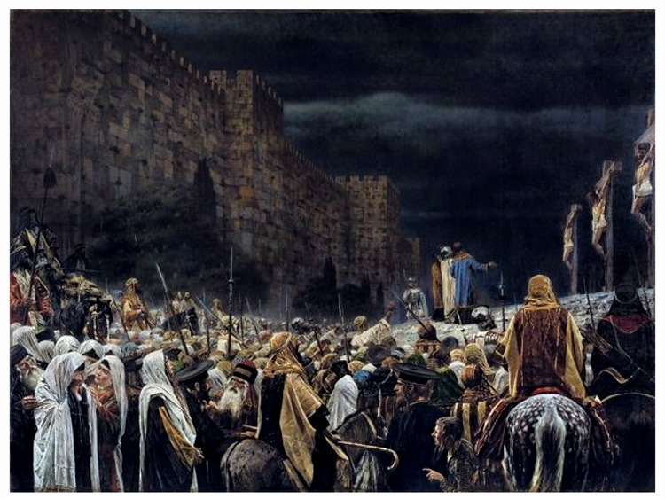
Julius Africanus cites Thallus (AD 52)
Mentions that one of Thallus’ books explains darkness from
Noon to 3pm During Jesus’ crucifixion
And attributed it to “an eclipse of the sun”
Julius Africanus was writing to say that Thallus’ explanation was “unreasonable”
Notes:
He attributes the darkness to a natural force, so no motive for him purposely trying to support Christianity (hence external evidence) -----------------------------------------------------------------
EXTRA: Thallus: – 3 volume account of Mediterranean area in 1st century, within 20 years of Jesus death. (no copies survived to today)
EXTRA: Julius Africanus..in AD 221 in his “History of the world”
Whole passage: “On the whole world there pressed a most fearful darkness; and the rocks were rent by an earthquake, and many places in Judea and other districts were thrown down. This darkness Thallus, in the 263 third book of his History, calls, as appears to me without reason, an eclipse of the sun. For the Hebrews celebrate the passover on the 14th day according to the moon, and the passion of our Savior fails on the day before the passover [see Phlegon]; but an eclipse of the sun takes place only when the moon comes under the sun. And it cannot happen at any other time but in the interval between the first day of the new moon and the last of the old, that is, at their junction: how then should an eclipse be supposed to happen when the moon is almost diametrically opposite the sun?” – Julius Africanus, Chronography, 18.1

Slide 14
Tacitus (AD 56-117)
Roman historian who wrote about Nero blaming Christians for the burning of Rome
We learn these details: -There were Christians in Rome -Jesus lived in Judea -Pontius Pilate crucified Jesus -Jesus’ followers were persecuted -Tacitus thought Christians were superstitious, abominations, hideous, and shameful…. So not a fan of Christians
Notes:
-------------------------------------------
“Consequently, to get rid of the report, Nero fastened the guilt and inflicted the most exquisite tortures on a class hated for their abominations, called Christians by the populace. Christus, from whom the name had its origin, suffered the extreme penalty during the reign of Tiberius at the hands of one of our procurators, Pontius Pilatus, and a most mischievous superstition, thus checked for the moment, again broke out not only in Judæa, the first source of the evil, but even in Rome, where all things hideous and shameful from every part of the world find their centre and become popular”

Slide 15
Mara Bar-Serapion (70 AD)
Syrian philosopher who wrote letter to son
Stated the people groups who killed Socrates and Pythagoras got what they deserved(punishment)
Stated that the Jews murdered “their wise king”
And that their ‘kingdom’ was ‘abolished’ because of it
But that the wise king “lived on in the teachings he enacted”
Didn’t name Jesus, but showed the impact He had
Notes:
-------------------------------------------------------
From quote: ”What advantage did the Athenians gain from putting Socrates to death? Famine and plague came upon them as a judgment for their crime. What advantage did the men of Samos gain from burning Pythagoras? In a moment their land was covered with sand. What advantage did the Jews gain from executing their wise king? It was just after that that their kingdom was abolished. God justly avenged these three wise men: the Athenians died of hunger; the Samians were overwhelmed by the sea; the Jews, ruined and driven from their land, live in complete dispersion. But Socrates did not die for good; he lived on in the teaching of Plato. Pythagoras did not die for good; he lived on in the statue of Hera. Nor did the wise king die for good; he lived on in the teaching which he had given” Reference: Bruce, F.F., The New Testament Documents: Are They Reliable?, p.117

Slide 16
Origen cites Phlegon (AD 80-140)
Origen wrote to writer named Celsus about what Phlegon’s writings said about Jesus:
Jesus was able to predict the future
Was crucified under Tiberius Caesar’s reign
3 hours of darkness
Also tells Celsus that he can check out Phlegon’s writings for himself to show that Phlegon actually said it, which suggests Phlegon’s writings were available at the time
Notes:
Origen was an Alexandrian Christian theologian responding to a Greek writer named Celsus
-------------------------------------------------------
Celsus wrote this: ”But,” continues Celsus… “although we are able to show the striking and miraculous character of the events which befell Him, yet from what other source can we furnish an answer than from the Gospel narratives, which state that ‘there was an earthquake, and that the rocks were split asunder, and the tombs opened, and the veil of the temple rent in twain from top to bottom, and that darkness prevailed in the day-time, the sun failing to give light?’” And Origen responded with the following:
“With regard to the eclipse in the time of Tiberius Caesar, in whose reign Jesus appears to have been crucified, and the great earthquakes which then took place, Phlegon too, I think, has written in the thirteenth or fourteenth book of his Chronicles” (Origen, Against Celsus, 2.33)…. He (Celsus) imagines also that both the earthquake and the darkness were an invention; but regarding these, we have in the preceding pages, made our defense, according to our ability, adducing the testimony of Phlegon, who relates that these events took place at the time when our Saviour suffered. (Origen, Against Celsus, 2.59)

Slide 17
Eusebius Quotes Phlegon
Phlegon was 600 miles away in Modern day Turkey
He wrote that there was an earthquake that “overthrew a great part of the city” of Bithynia
Said there was “a great eclipse of the sun” at noon
Stars were visible
Phlegon said nothing of Christ’s crucifixion, probably because he was 600 miles away when it happened
Notes:
Folks try to discount this observation from Phlegon as not related to the death of Christ because it was too far from where Jesus was crucified.
The Bible did not state that the whole planet was affected, but also does not state that it wasn’t Also, imagine how a bias against the supernatural could weigh in on how someone interprets the evidence
--------------------------------------
"However in the fourth year of the 202nd olympiad [32 CE], an eclipse of the sun happened, greater and more excellent than any that had happened before it; at the sixth hour [around noon] day turned into dark night, so that the stars were seen in the sky, and an earthquake in Bithynia toppled many buildings of the city of Nicaea."

Slide 18
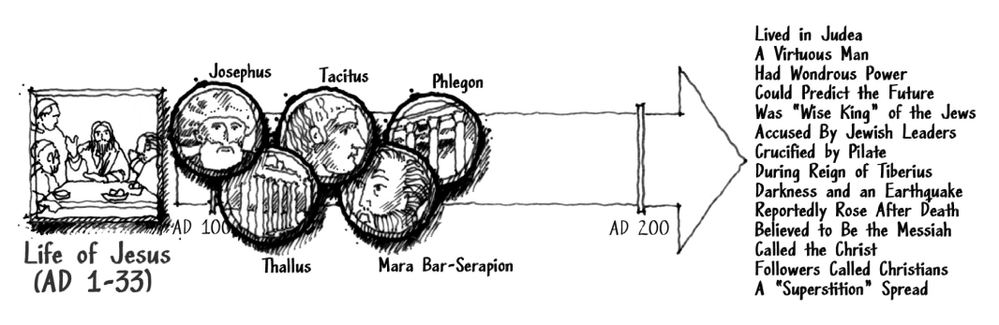
External Corroborating Evidence Summary

Slide 19
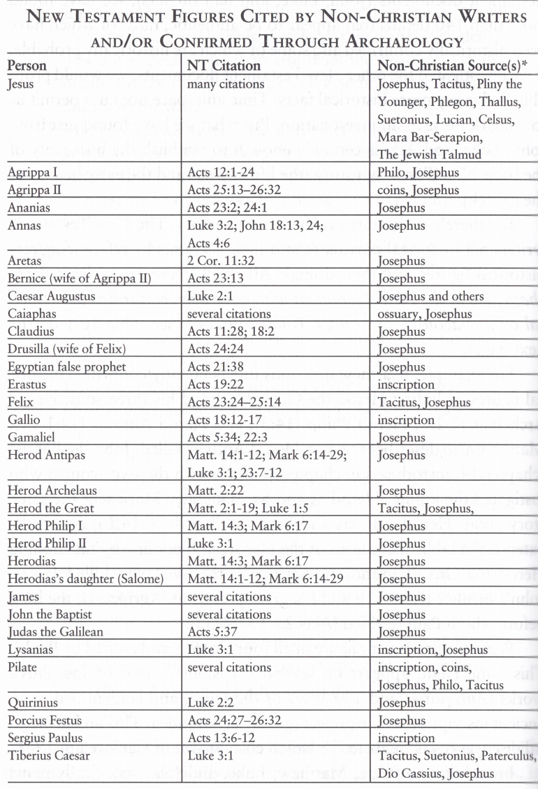
New Testament People cited by (corroborated) non-Christian writers and/or through archaeology
Notes:
This is not an exhaustive list.
What else could New Testament authors have written to prove they were eyewitnesses who were not making up a story?
------------------------------------------------------------------------ From “I Don’t Have Enough Faith to Be an Atheist”

Slide 20
Historical Fiction?
Historical novelists who write fiction usually do not use the name of real people for the main characters in their stories.
If they did, those real people, especially powerful government and religious officials would deny the story and possibly punish the novelist.
“Realism” in literature did not start until the 1850’s
Notes:
-Realism::
Writing fiction with realistic details did not exist when the gospel accounts were written

Slide 21

Internal Corroborating Evidence

Slide 22
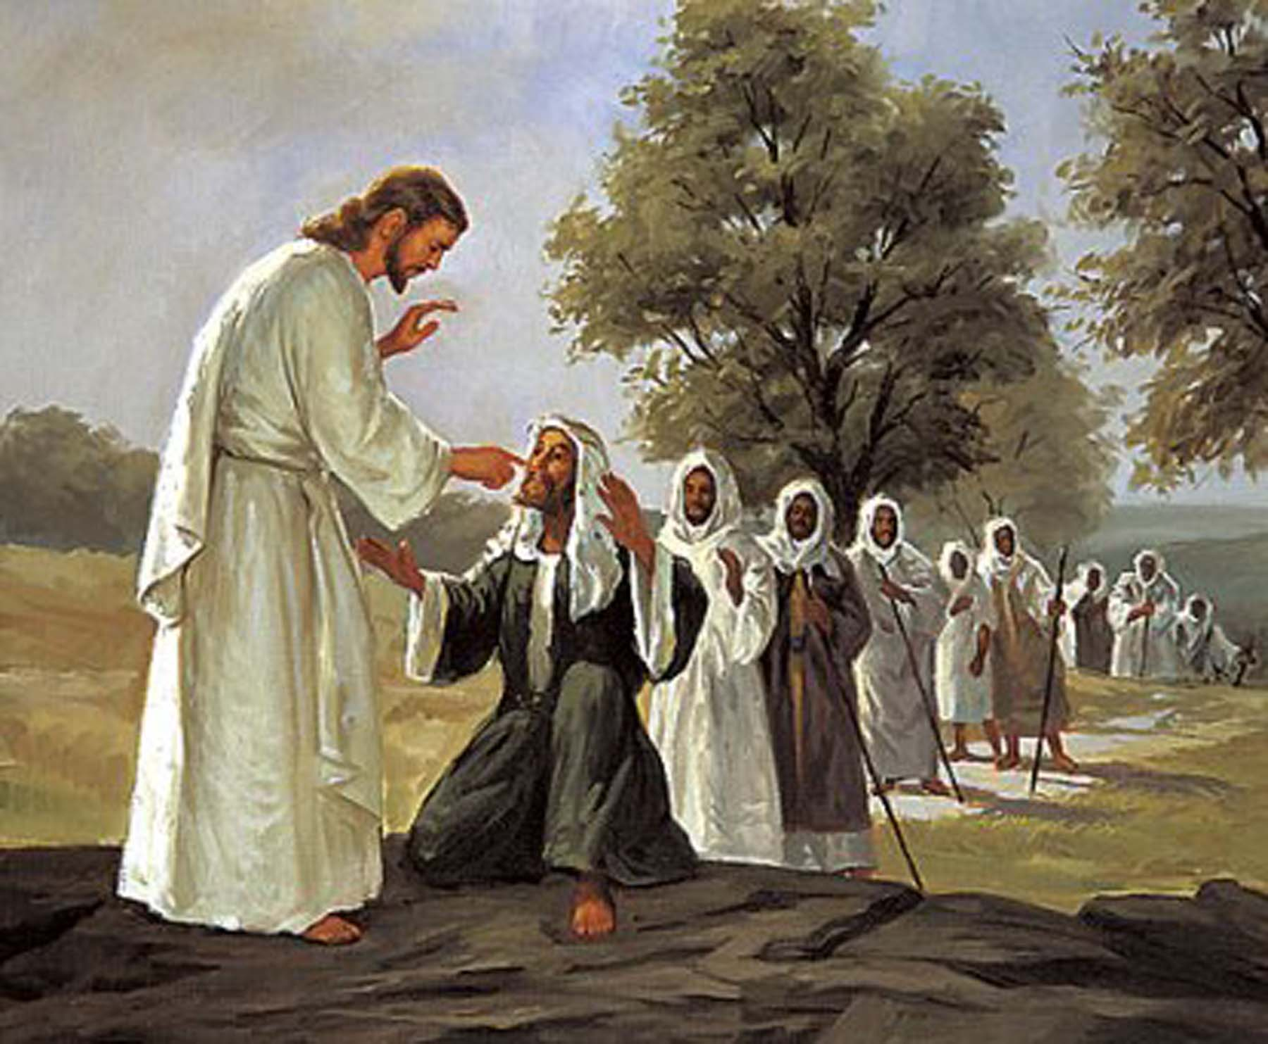
Unintentional Support
Matthew 8:16 says: ”That evening they brought to him many who were oppressed by demons, and He(Jesus) cast out the spirits with a word and healed all who were sick.”
Why did they wait till evening to come to Jesus
Answer: Some of Jesus’ followers were from Herod’s household. (Luke 8:3)

Slide 23
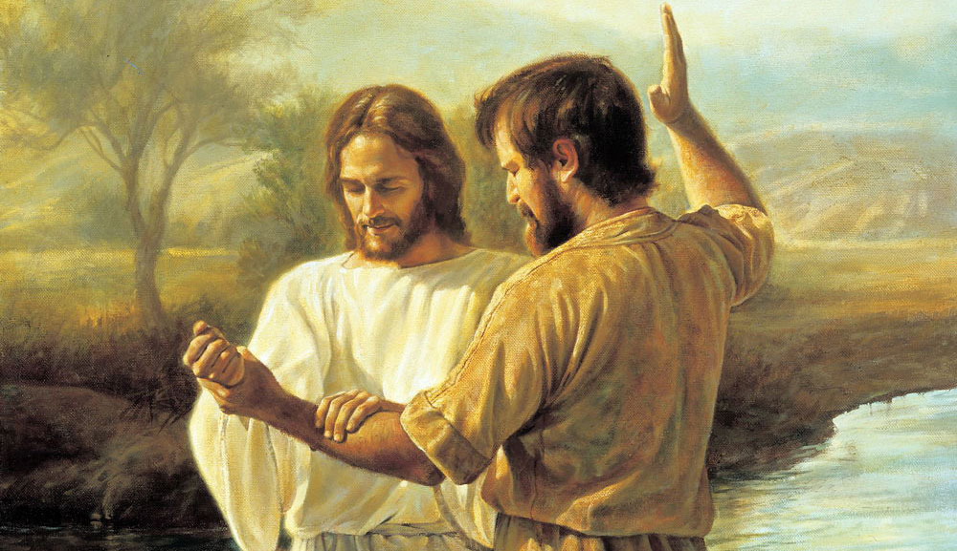
Herod’s Servants
Why did Herod tell his servants that he thought Jesus was John the Baptist, raised from the Dead? Matt 14:1-2
Where would Herod get that idea from?
Answer: Some of Jesus’ followers were from Herod’s household. (Luke 8:3)

Slide 24
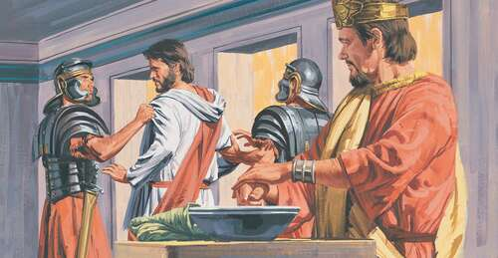
Why No Charge Against Jesus?
Luke 23:1-4 Pilate found no fault in Jesus even though Jesus said he was a king. Why?
Answer: John 18:33-38 Jesus said His kingdom is not of this world, meaning his kingdom is not a threat to Rome.

Slide 25
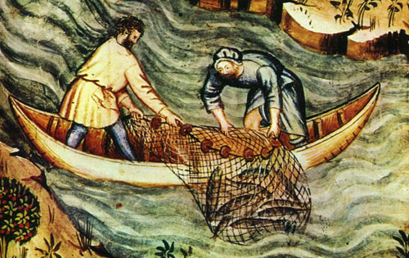
Matthew does not tell us why
Matt 4:18-22 Jesus calls Peter, Andrew, James and John who “immediately” left their nets to follow Jesus when prompted.
Why?
Luke 5:1-11 Tells us that they already saw Jesus do a miracle when their nets were overflowing with fish after Jesus told them to cast on the other side. So while they were still mending their nets, Jesus called them to follow. Otherwise, it seems odd that fishermen would leave their livelihood for Jesus.
Notes:
Ever got the impression that Jesus randomly called a bunch of guys together who followed Jesus after only meeting Him for the first time?
A review of all the gospel accounts reveal otherwise.

Slide 26

Corroboration by Language

Slide 27
Language Consistent with 1st century
In the gospel writings:
John’s language – consistent with a 1st century fisherman
Luke’s language – consistent with a 1st century doctor

Slide 28
Content Matched the Time Period
Most popular names in gospels match 1st century Palestine
Common names had extra qualifiers. ie.) Simon Peter, Simon the Zealot, Simon the Tanner, Simon the Leper, Jesus of Nazareth, Jesus the Galilean
Writing style consistent with the time period
Many non-famous towns were mentioned by gospel writers. Authors of late forgeries could not know such minute details.
Notes:
------------------------------------------------------------------------
Disambiguation. By the way... There is no such thing as a “Palestinian” people. ”Palestine” was a derogatory, demeaning name that the Romans gave to the Jewish lands, in an attempt to suggest that the land belonged to the Philistines instead of the Jews (their mortal nemesis)… to minimize Jewish attachment to the land. The people who call themselves “Palestinians” are a made-up group of people.

Slide 29
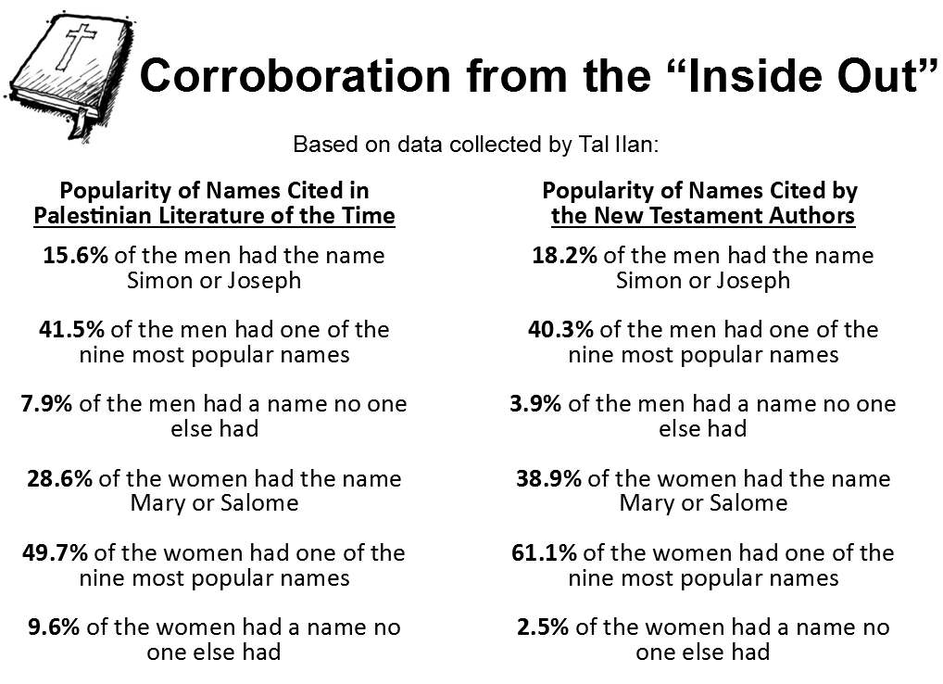
Notes:
For 1st century Palestine, we see a comparison between
secular and New Testament writings: The likelihood of a late/forgery writer getting the right names for the time period would be highly unlikely. We see yet another ‘lottery’ that the gospel writers won.

Slide 30
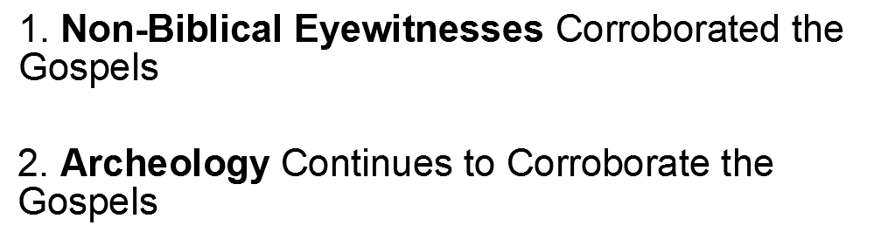
External Corroborating Evidence

Slide 31
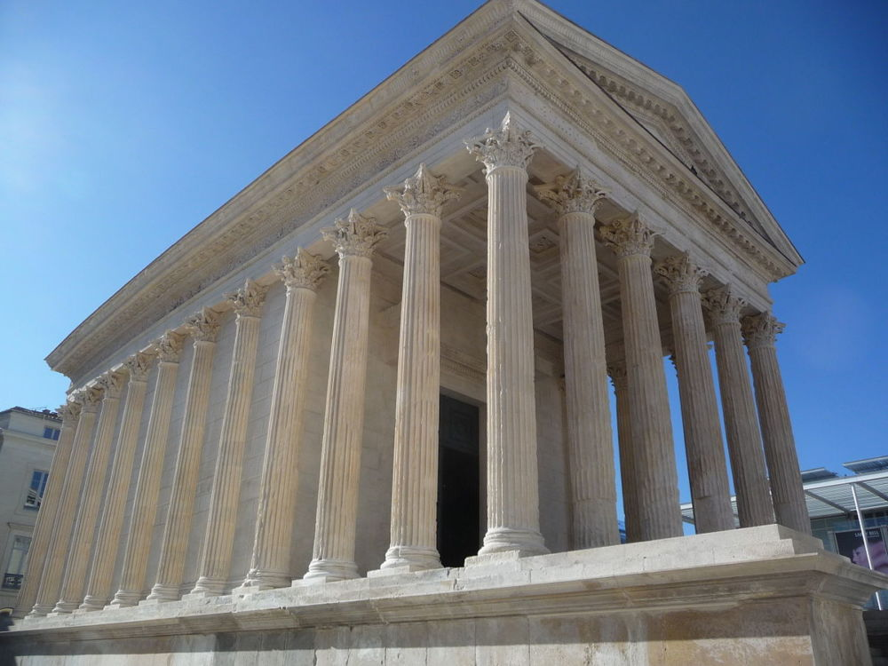
External Corroboration via Government

Slide 32
Roman Citizenship
Luke accurately describes 2 paths to Roman citizenship
“The tribune answered, “I bought this citizenship for a large sum.” Paul said, “But I am a citizen by birth.” (Acts 22:28)
Luke correctly described the manner in which a man could invoke his Roman citizenship and appeal his case to Caesar (Acts 25:6–12.)
Notes:
Luke accurately described the government that existed in first-century Palestine under Roman rule.
His account demonstrates that he was writing at the time and place he claimed

Slide 33
Roman Imprisonment
Luke correctly described the way that prisoners in Rome could do house arrest at their own expense.
Acts 28:16 16 And when we came into Rome, Paul was allowed to stay by himself, with the soldier who guarded him.
Acts 28:30-31 30 He lived there two whole years at his own expense, and welcomed all who came to him, 31 proclaiming the kingdom of God and teaching about the Lord Jesus Christ with all boldness and without hindrance.

Slide 34
Why do some continue to deny?
“Troublesome” gospel terms
Matt 6:5 says that the ‘hypocrites’ prayed in the synagogues. whereas some Jewish scholars say that the Jews of Jesus’ day did not pray in synagogues until after the temple destruction in AD 70.
Notes:
Objections like these presume that we have a perfect knowledge of the 1st-century environment in Palestine.
-
There is no archaeological or ancient-document evidence that contradicts the claims of the gospel writers.
-
The bible is put to a much higher standard by skeptics than any other ancient text, which they readily accept.
-
Ie.) We don’t even know if writings attributed to Plato actually were written by him.

Slide 35
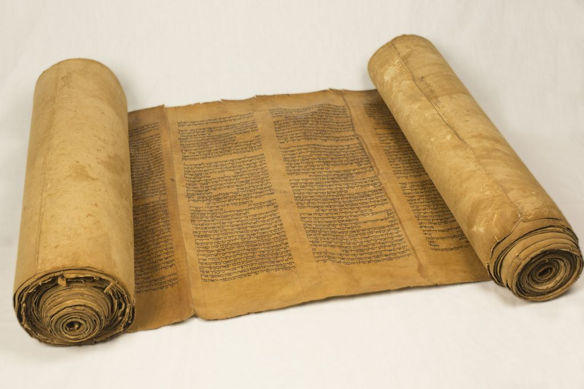
Unreasonable Expectations
Skeptics want all parts of gospels corroborated with external evidence
Some original writings of ancient authors missing
Idea that ancient folks were easier to ‘fake’ miracles to
Notes:
-Albert Einstein quote said that the gospels are a product of human weakness.
-Skeptics say we can’t trust the Christian authors such as:
Sextus Julius Africanus and Origen in case they misquoted the texts from Thallus or Phlegon.
But they were quoting criticisms about Christianity. There’s no self-fulfilling motive to that.

Slide 36
Ancient folks not as gullible as we might think
Matthew 28:16-17 16 Then the eleven disciples went away into Galilee, to the mountain which Jesus had appointed for them. 17 When they saw Him, they worshiped Him; but some doubted.
Notes:
Why would people making up a new religion say that some folks who saw the resurrected Jesus still doubted?

Slide 37
Why do some continue to deny?...
There have been a number of cases where skeptics pointed out what they thought were discrepancies about: -Historical figures -Locations
But archaeological findings have cleared a lot of those up
Notes:
Just because we don’t have archaeological evidence for a given person or location doesn’t mean a given gospel account was false. Ancient history is hard to come across because most of it has been destroyed.

Slide 38
Evidence doubters
Believing that miracles are not possible is huge presupposition that can make any evidence seem not good enough
ie.) How could archaeology show that Jesus healed a blind man? Archaeology is helpful, but limited.

Slide 39
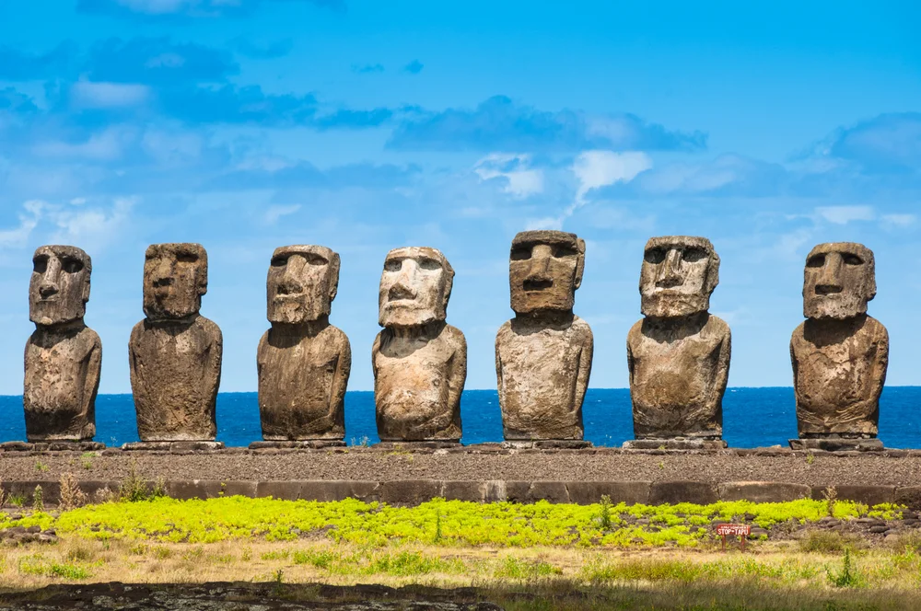
Objection: There is no natural explanation for “how” miracles are possible; therefore I say they can’t happen.
Just because we can’t explain how miracles are possibles does not mean they cannot happen
The “Moais” carvings in the SW Pacific Ocean area of ‘Easter Island’
No one knows for sure ‘how’ they were made and transported
But that doesn’t mean we can say they don’t exist
Notes:
“Stonehenge” is another such example. or the pyramids
------------------------------------------------------------------------
Pg 396 of “Darwin’s Doubt”

Slide 40
Worldview means everything
An NBC News survey in 2004 (approx 10 years after trial) showed that 77% of people believed that Simpson was guilty. However, 87% of whites in that survey said guilty whereas only 29% of blacks thought he was guilty. -They the police planted the evidence, which is what skeptics have accused the gospel writers of.
Notes:
Remember that even with the same evidence, folks will often interpret the evidence with their worldview.
Why else do we pay attention to the political affiliation of politicians when decisions are made? We realize that worldview affects how people make decisions.
Few ancient records have been as critically examined as the bible.

Slide 41

Evidence – big picture
No one piece of evidence is ever enough
Court cases rely on many pieces that when compiled together tell an accurate depiction of what happened
Circumstantial evidence weak on its own, but strong with many pieces
Notes:
Consider these pieces of circumstantial evidence from the O. J. Simpson case and how each additional piece makes the case stronger:
-Simpson’s blood found at scene of murder.
-A rare matching glove at the crime scene matched to a glove pair at Simpson’s house.
-More of Simpson’s blood on glove at scene of murders.
-Simpson’s hair found at crime scene
-Simpson owned shoes that made same impression as the blood foot prints at crime scene
-Simpson’s bedroom had pair of socks with blood on them that had both Simpson’s blood and blood of the victim.
-
If there is a suspicion that any evidence was ‘planted’, that is where the ‘chain of custody’ is extremely important.

Slide 42
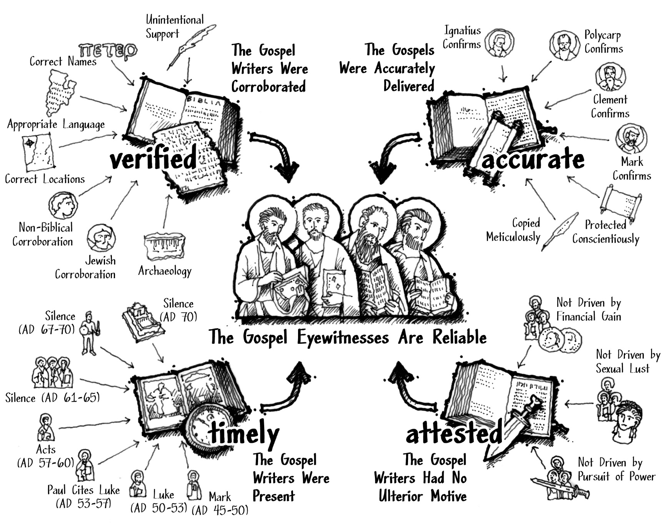
Notes:
The gospel writers provided
-Unintentional support: With truthful witnesses, we expect their claims to unintentionally corroborate with other facts
-For a liar, we would expect them to unintentionally give claims that could not be possible, even from their perspective

Slide 43
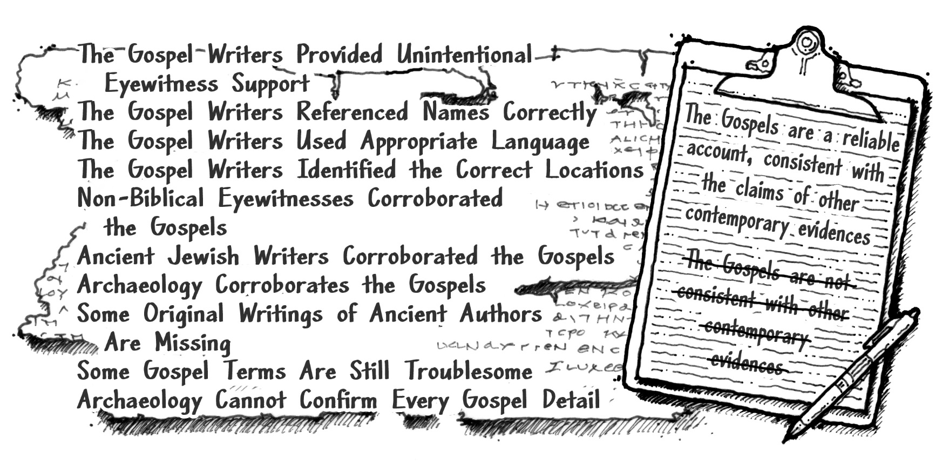
The Gospels Pass the Second Test
Notes:
The Gospels have passed the first two tests; their testimony appears early enough in history, and their claims can be corroborated. Now we have to make sure they haven’t been corrupted over time. The 3rd test will be to make sure that the accounts we have today are accurate in that they were not altered from when the authors wrote their original accounts.

Slide 44
for more information visit:
www.ColdCaseChristianity.com

